Slide 1
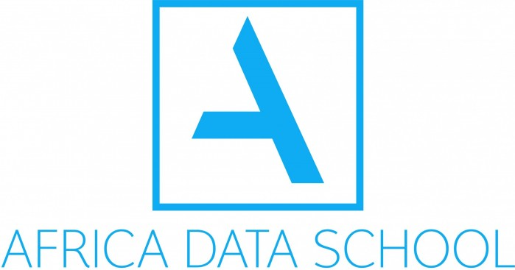

DATA SCIENCE FRAMEWORK & TOOLS

Slide 2
AGENDA
Applied Data Science
CRISP -DM Project Framework
How the World’s Biggest Companies Design Machine Learning-Powered Applications
Data tools

Slide 3

Applied Data Science
Applied data scientists
Applied scientists use Data science and ML to improve business outcomes (e.g., revenue, cost, customer experience).
The systems they build may be internal (e.g., product classification, fraud detection) or customer-facing (e.g., search, recommendations).
Outside of use-case driven applications, they might also develop internal datasets, tooling, and methodology (e.g., feature stores, package/docker templates, model testing & release checks)
Applied data scientists have higher and deep technical knowledge of how data science and its methods work.
©2021 Proprietary and Confidential. All Rights Reserved.
3

Slide 4
Applied Data Science
Applied data scientists
Applied scientists use Data science and ML to improve business outcomes (e.g., revenue, cost, customer experience).
The systems they build may be internal (e.g., product classification, fraud detection) or customer-facing (e.g., search, recommendations).
Outside of use-case driven applications, they might also develop internal datasets, tooling, and methodology (e.g., feature stores, package/docker templates, model testing & release checks)
Applied data scientists have higher and deep technical knowledge of how data science and its methods work.
©2021 Proprietary and Confidential. All Rights Reserved.
4

Slide 5
Applied Data Science
Applied data scientists
Applied scientists use Data science and ML to improve business outcomes (e.g., revenue, cost, customer experience).
The systems they build may be internal (e.g., product classification, fraud detection) or customer-facing (e.g., search, recommendations).
Outside of use-case driven applications, they might also develop internal datasets, tooling, and methodology (e.g., feature stores, package/docker templates, model testing & release checks)
Applied data scientists have higher and deep technical knowledge of how data science and its methods work.
©2021 Proprietary and Confidential. All Rights Reserved.
5

Slide 6
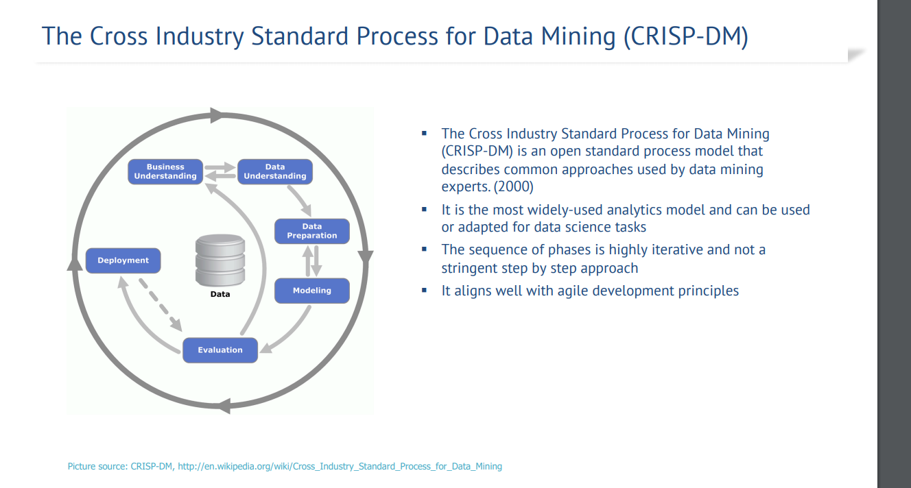

Slide 7
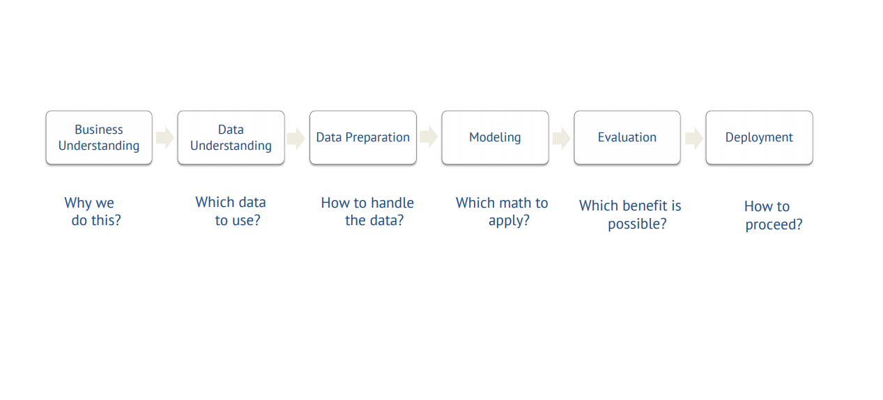
CRISP-DM breaks the process of data mining into six major phases

Slide 8
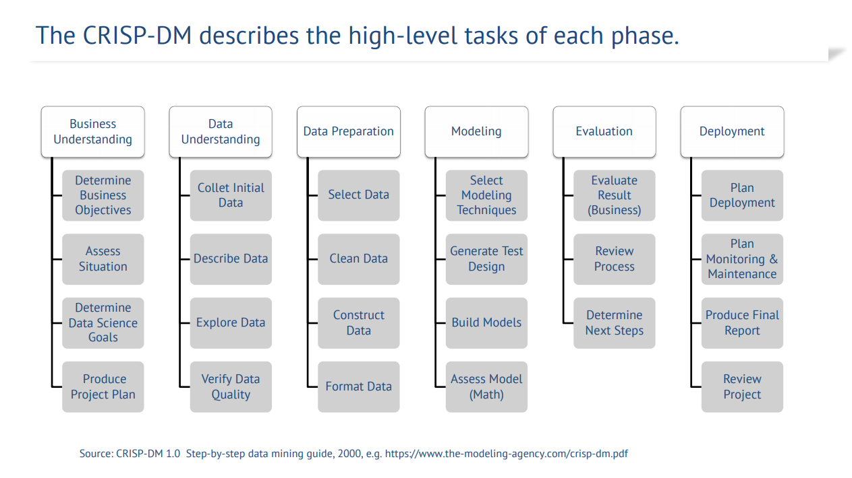

Slide 9
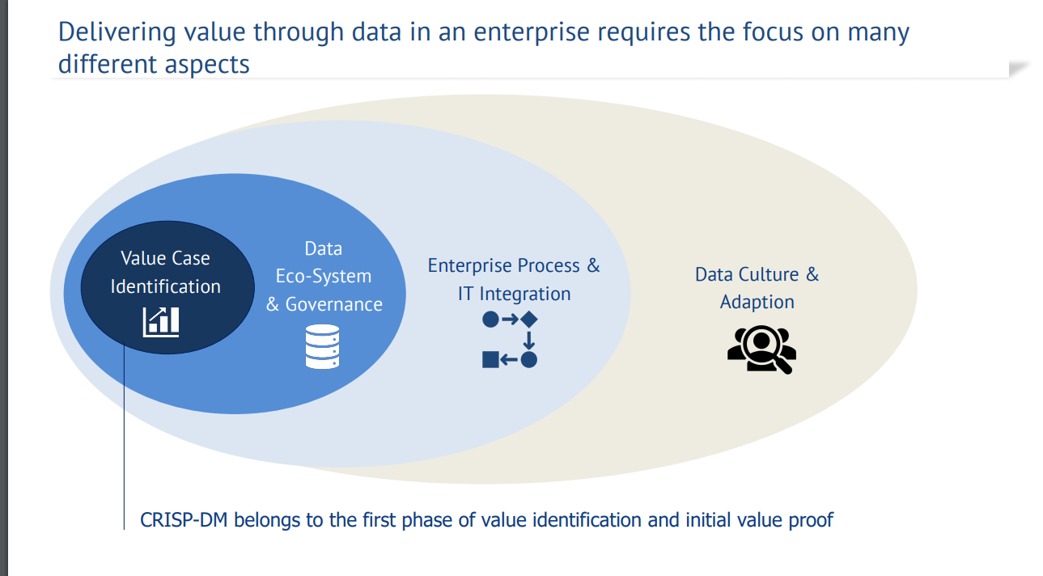

Slide 10
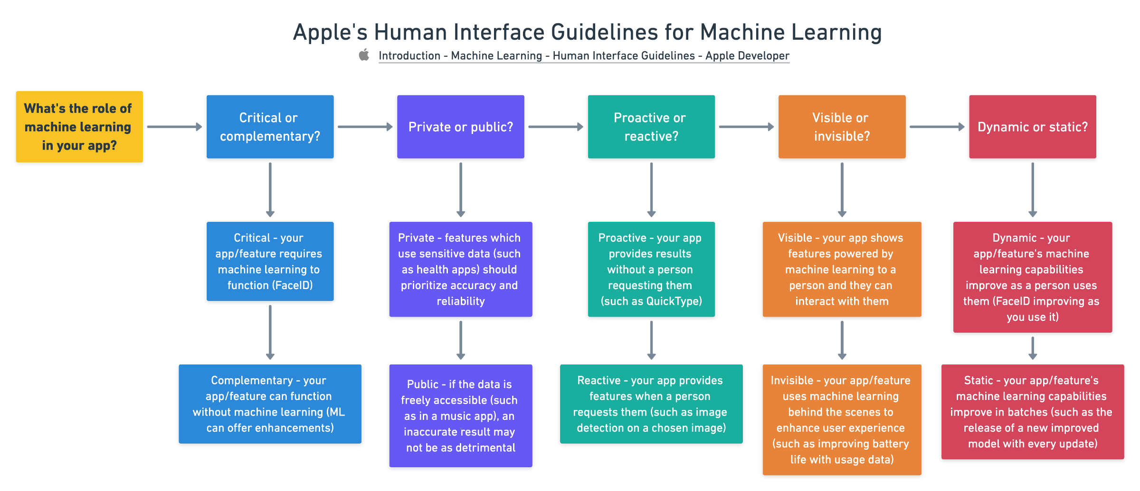
APPLE

Slide 11
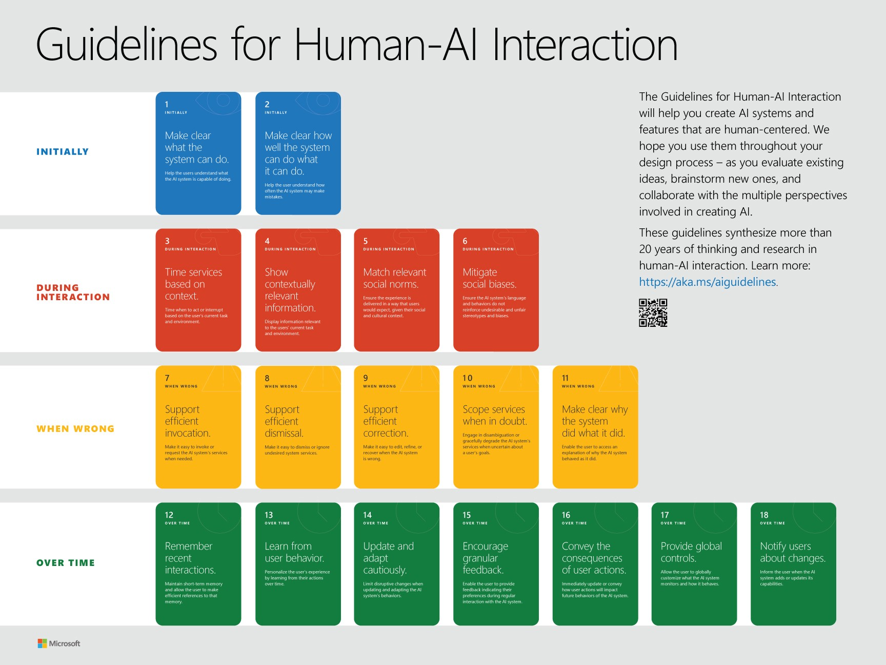
MICROSOFT

Slide 12
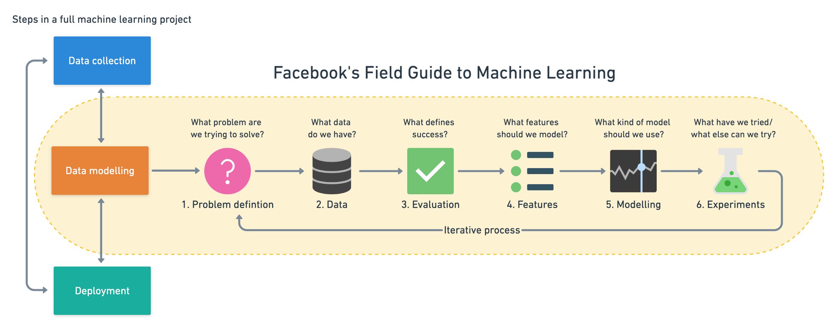
Facebook
Notes:
1)CRISP-DM: https://www.the-modeling-agency.com/crisp-dm.pdf 2)What’s the Difference Between a Data Scientist, Research Scientist, and an Applied Scientist? https://towardsdatascience.com/whats-the-difference-between-a-data-scientist-research-scientist-and-an-applied-scientist-30c04190c1fa 3)How the World’s Biggest Companies Design Machine Learning-Powered Applications https://towardsdatascience.com/how-the-worlds-biggest-companies-design-machine-learning-powered-applications-701f4114e089

Slide 13
TOOLS

Slide 14
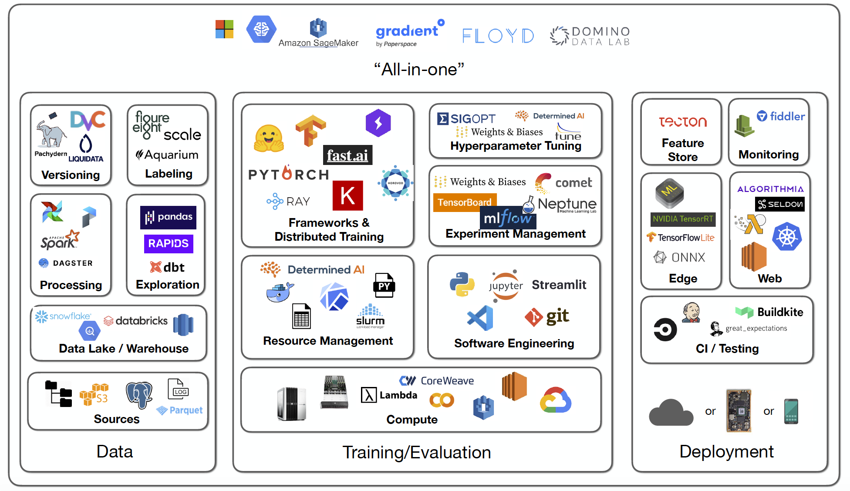

Slide 15
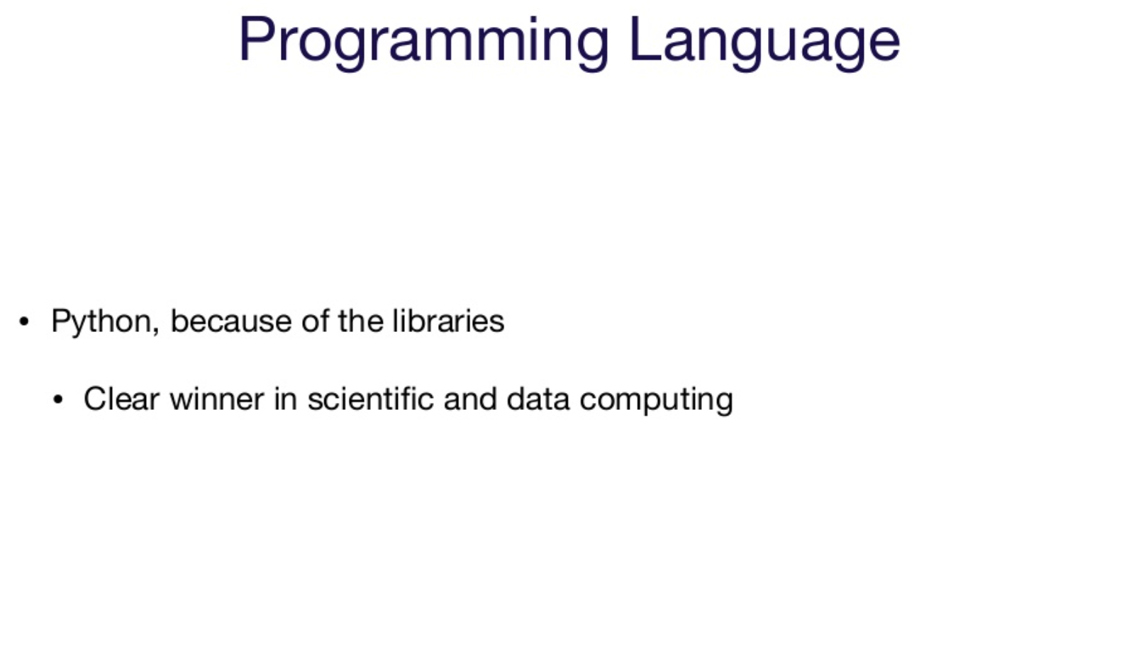

Slide 16
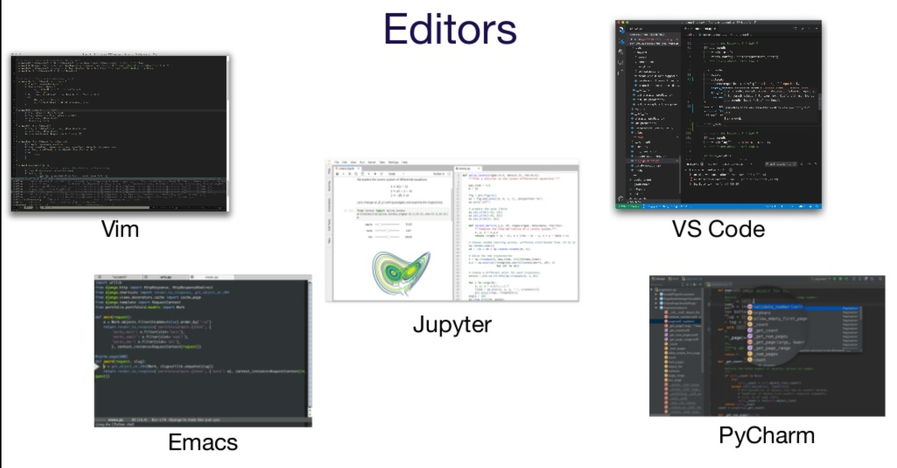
Notes:
Beyond Interactive: Notebook Innovation at Netflix https://netflixtechblog.com/notebook-innovation-591ee3221233

Slide 17
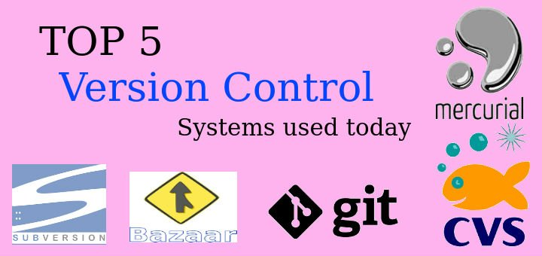
Version control (GIT & GITHUB)

Slide 18
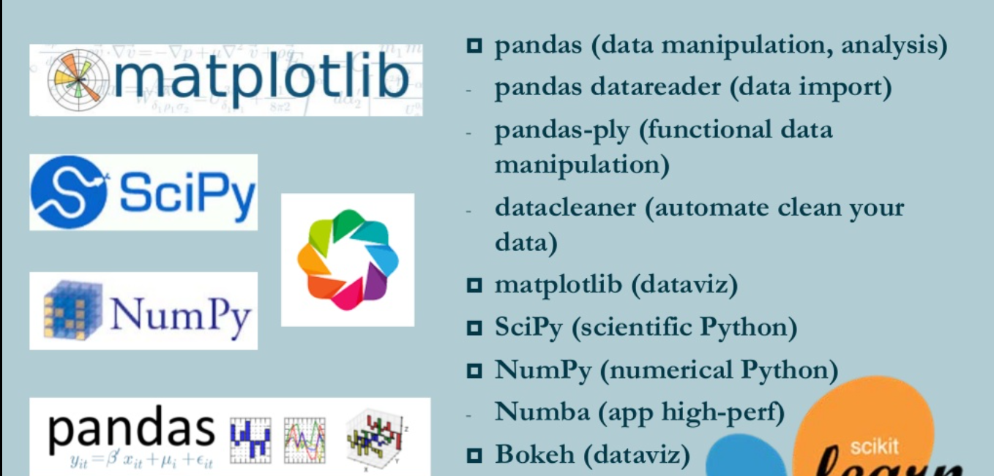
DATA ANALYSIS ( Pandas & NumPy)

Slide 19
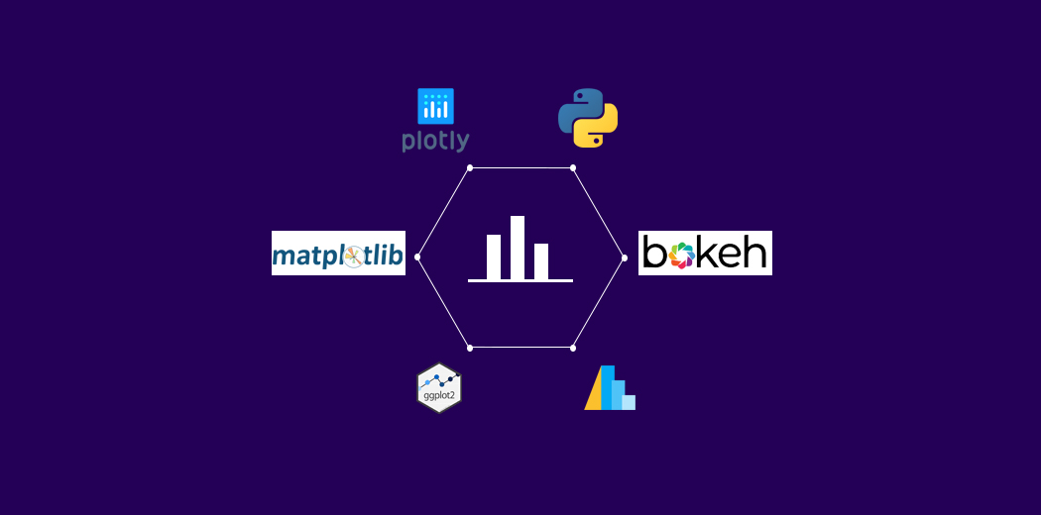
DATA VISUALIZATION (Matplotlib, Seaborn& Plotly)

Slide 20
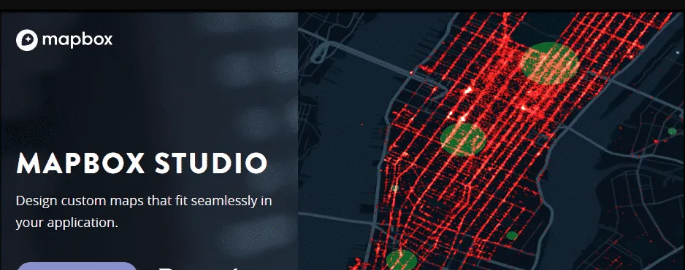
Maps & location (Mapbox)

Slide 21
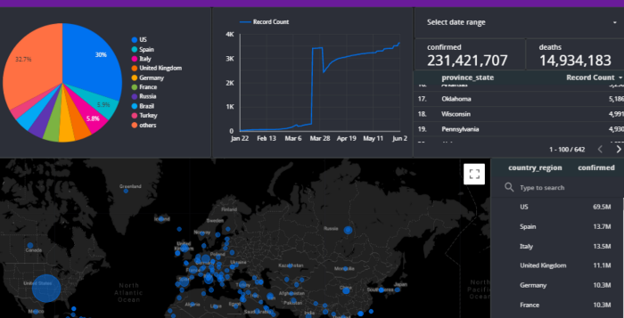
DASHBOARD (DASH & STREAMLIT)

Slide 22
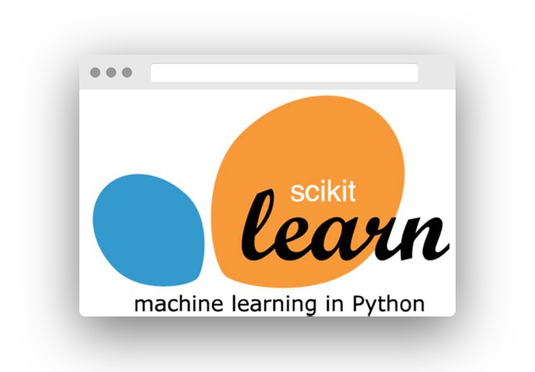
MACHINE LEARNING (Sklearn)

Slide 23
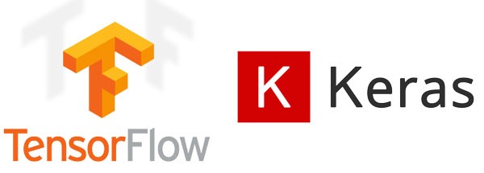
DEEP LEARNING

Slide 24

Natural language processing

Slide 25
Set up
1
Google Colabs
2
Anaconda
©2021 Proprietary and Confidential. All Rights Reserved.
25

Slide 26
Read more
1)CRISP-DM:
https://www.the-modeling-agency.com/crisp-dm.pdf
2)What’s the Difference Between a Data Scientist, Research Scientist, and an Applied Scientist?
https://towardsdatascience.com/whats-the-difference-between-a-data-scientist-research-scientist-and-an-applied-scientist-30c04190c1fa
3)How the World’s Biggest Companies Design Machine Learning-Powered Applications
https://towardsdatascience.com/how-the-worlds-biggest-companies-design-machine-learning-powered-applications-701f4114e089
4) Beyond Interactive: Notebook Innovation at Netflix
https://netflixtechblog.com/notebook-innovation-591ee3221233

